Slide 1


To listen for specific information about invitations(邀请)
To learn to make, accept and decline invitations
Can you come to my party on…?
Sure, I’d love to.
Sorry, I can’t. I have to/must…
To revise and learn the words and expressions: prepare for an exam, have the flue, help one’s parents, meet one’s friends, go to the/ a doctor, available, another time, go bike riding, not …until, hang out, catch

Slide 2


T: I’m really busy on weekdays. I need to relax on weekends. What can I do to relax?
S: You can go shopping.
S: You can go to the movies.
S: You can …
T: New Year’s Day is coming. I’m going to have a New Year’s Party at home. Can you come to my party?
S: Yes, I’d love to./ Sorry, I have to…

Slide 3
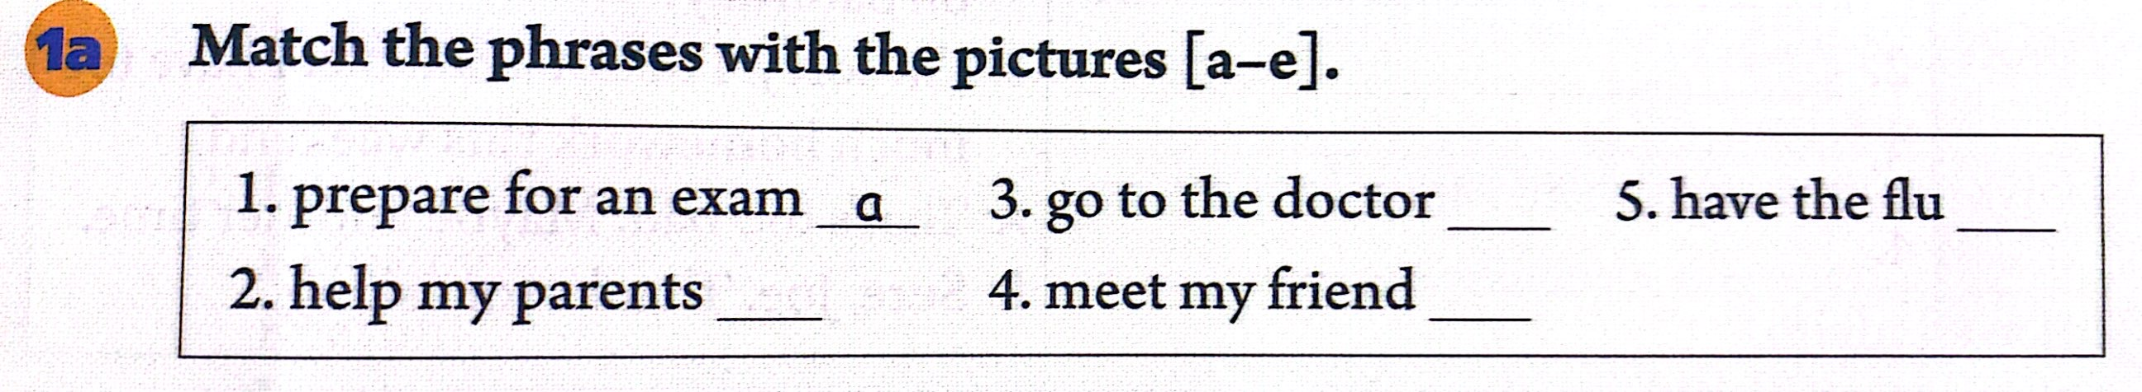
prepare for 为......做准备
exam n. 考试
prepare for an exam 为考试做准备
go to the/a doctor 去看医生
flu n. 流行性感冒
have the flu 得了流行性感冒/流感
[ɪɡˈzæm]
[fluː]

Slide 4

Review
go to the / a doctor
____________________ 去看医生
__________________________________ 备考
___________________ 患流感
help my parents _________________
meet my friends _________________
____________________ 在星期六下午
last fall ________________________
go bike riding ____________________
_______________ 闲逛；常去某处
prepare for an exam / study for a test
have the flu
帮助我的父母
见我的朋友
on Saturday afternoon
去年秋天
骑自行车兜风
hang out

Slide 5

Unit 9

Slide 6

Unit 9
Can you come to my party?

Slide 7



Slide 8
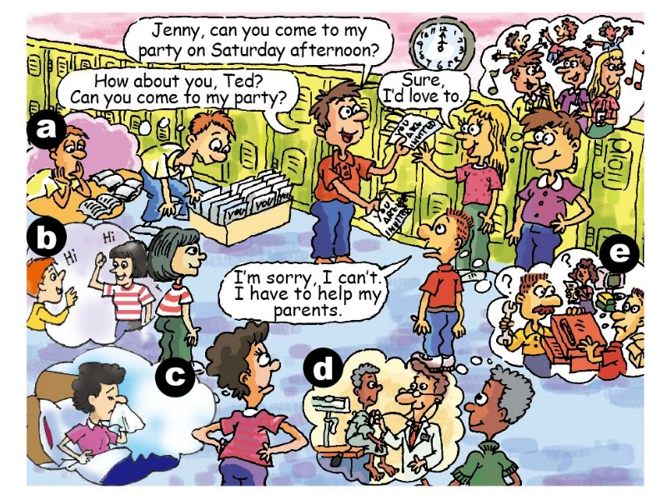
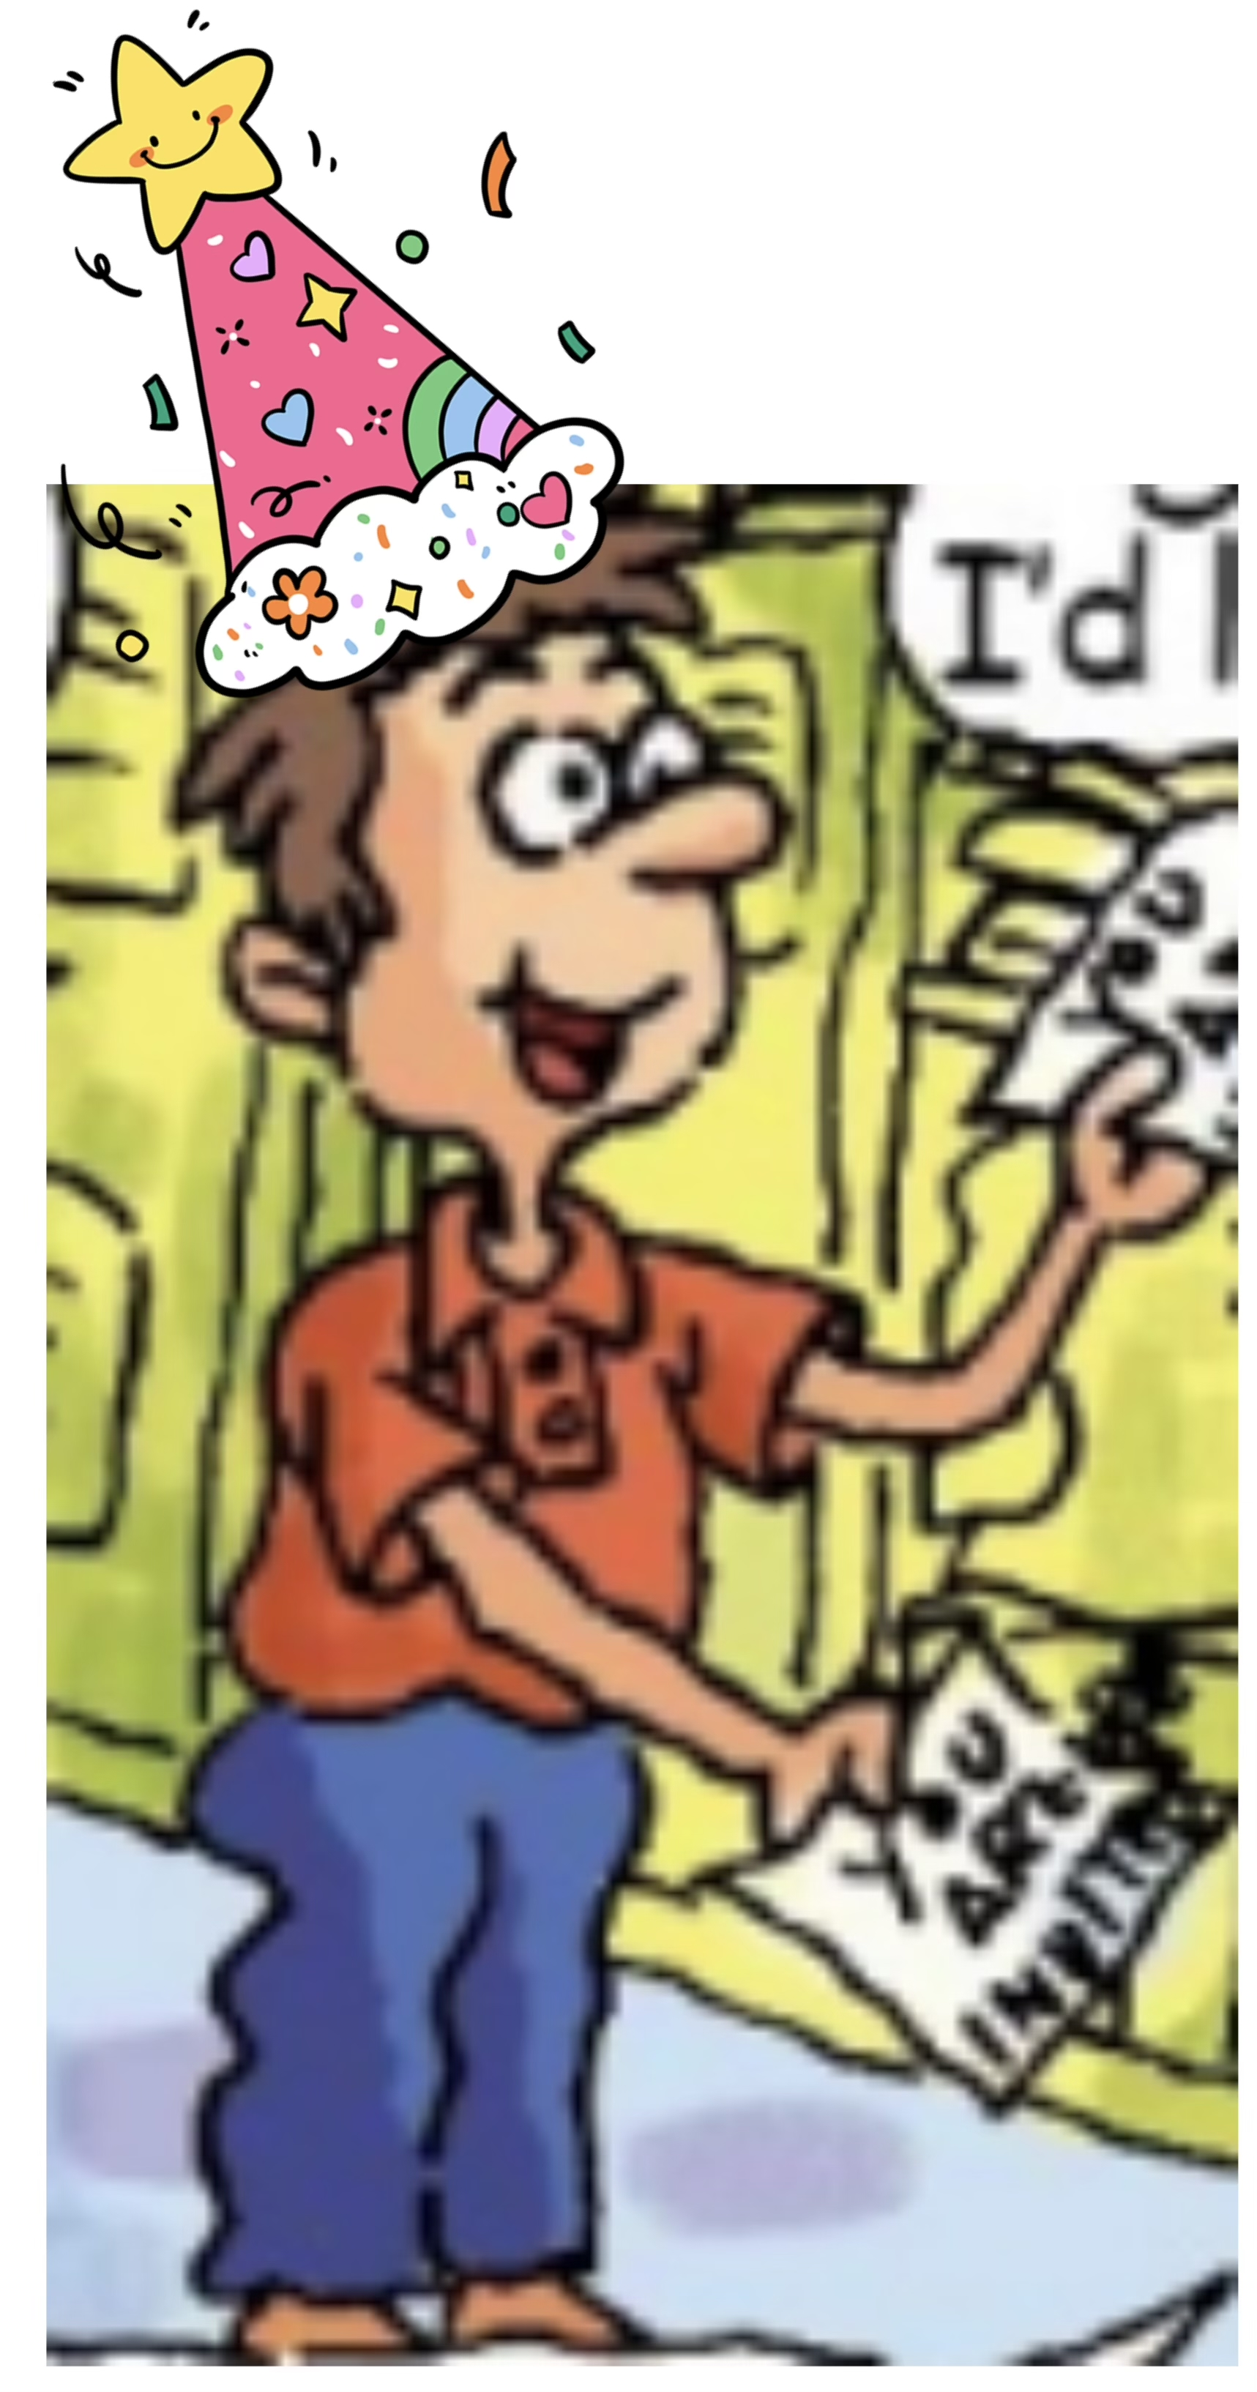
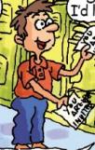
make an invitation
Presentation
[ˌɪnvɪˈteɪʃn] n. 邀请
Sun Ning
His birthday’s on Saturday.
He will have a birthday party.
Can you...?/
Would you like to...?/
Would you love to...?

Slide 9
Presentation
accept the invitation or refuse the invitation
[əkˈsept] v. 接受
[rɪˈfjuːz] v. 拒绝

Slide 10

How to accept the invitation showing your happiness?
Sun Ning: Can you come to my party on Saturday afterday?
Jenny: Yes, I’ d love to./
Sure, I’d love to./
Sure, it sounds great.
Jenny

Slide 11
Presentation
How to refuse the invitation politely?

Slide 12
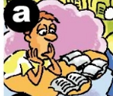
How to refuse the invitation politely?
Sun Ning: Can you come to my party on Saturday afterday?
Sorry, I can’t.
I must prepare for an exam.
prepare for an exam
为考试做准备
[ɪɡˈzæm]

Slide 13
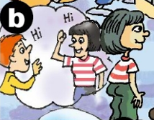
How to refuse the invitation politely?
Sun Ning: Can you come to my party on Saturday afterday?
I’m Sorry, I can’t.
I have to meet my friend.
meet my friend

Slide 14
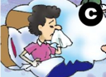
How to refuse the invitation politely?
Sun Ning: Would you like to come to my party?
I’m afraid not.
I have the flu.
have the flu
得了流行性感冒
[fluː]

Slide 15
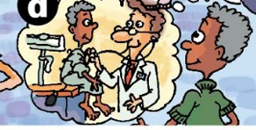
How to refuse the invitation politely?
Sun Ning: Would you love to come to my party?
I’d love to, but I’m afraid not.
I might have to go to the doctor.
go to the doctor

Slide 16
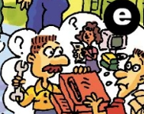
How to refuse the invitation politely?
Sun Ning: Would you love to come to my party?
Sorry, I’m not available.
I might have to help my parents.
[əˈveɪləbl] adj.有空的
help my parents

Slide 17


Match the phrases with the pictures (a-e).
reasons
1. prepare for an exam ______
2. help my parents ______
3. go to the doctor ______
4. meet my friend ______
5. have the flu ______
a
e
d
b
c

Slide 18
Summary
make an invitation
accept an invitation
Can you...?
Would you like to...?
Would you love to...?
Yes, I’ d love to.
Sure, I’d love to.
Sure, it sounds great.
refuse an invitation
give a reason
Sorry, I can’t.
I’m sorry, I can’t.
I’m afraid not.
I’d love to, but I’m afraid not.
Sorry, I’m not available/free.
I must...
I have to...
I might have to...
I ...

Slide 19



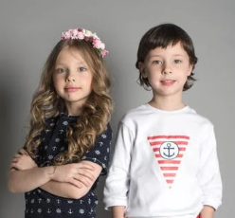
[ɪnˈvaɪt] v.邀请
Student A invites student B to do something. Student B says you can’t go and why. Write some more reasons in the chart.
Hey, ...
Can you ... on Saturday?
I’m sorry. I’m not available.
I ... this weekend.
That’s too bad. Maybe another time.
Sure, ... Thanks for asking.
Reasons:1. too much homework 2. ________________
3. ____________________ 4. ________________
visit grandparents
have piano lessons
go to a concert

Slide 20



Listen and write the names (Tim, Kay, Anna and Wilson) next to the correct students in the picture.
Tim
Anna
Kay
Wilson
a.
b.
c.
d.
e. Ted

Slide 21
Sun Ning: Hey, Ted. Can you come to my party on Saturday afternoon?
Ted: I’m sorry, I can’t, Sun Ning. I have to help my parents.
Sun Ning: Too bad. How about you, Jenny? Can you come to my party?
Jenny: I’d love to.
Sun Ning: Tim? What about you?
Tim: When is it?
Sun Ning: Saturday afternoon.
Tim: Oh, no, I can’t. I have to prepare for an exam.
Sun Ning: What about you, Wilson?
Wilson: Sorry, I must go to the doctor.
Sun Ning: Anna, can you come?
Anna: I can’t, Sun Ning. I might have to meet my friend.
Kay: I can’t either, Sun Ning. I have the flu.
Sun Ning: That’s too bad, Kay. Oh, maybe next time. What a small party!

Slide 22

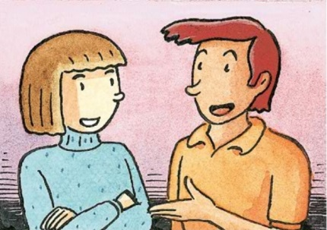
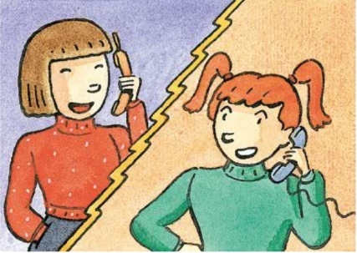
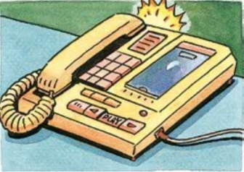
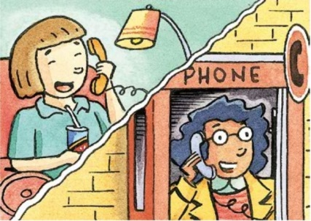
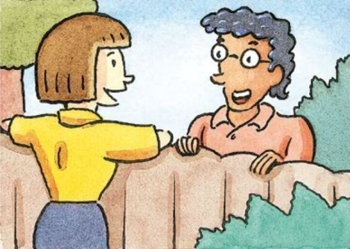
Listen and circle can or can’t.
Anna
1. Jeff (can / can’t ) go to the party.
2. Mary (can / can’t) go to the party.
3. May (can / can’t) go to the party.
4. Mei Ling (can / can’t) go to the party.
5. Paul (can / can’t) go to the party.

Slide 23

Who can’t go to the party?
Why? Listen again. Complete the chart.
Names | Reasons
Jeff
He might have to meet his friend.
May
She has the flu.
Mei Ling
She must study for a math test.

Slide 24
Let’s translate.
根据课本内容, 完成下列句子。
1. 星期六你能来我的聚会吗？
_______ you _______ to my party on Saturday?
2. 当然, 我乐意去。
Sure, _______ _______ _______.
3. 对不起, 我必须为数学考试备考。
Sorry, I _______ ____________ _______ a math test.
Can come
I’d love to
must study/prepare for

Slide 25
4. 明天晚上你能去看电影吗？
_______ you _______ to the movies tomorrow night?
5. 当然可以, 听起来很棒。
_______. That _________ _______.
6. 恐怕不行, 我得了流感。
I’m ________ not. I have the _______.
7. 他能参加聚会吗？
_______ he _______ to the party?
8. 不能。他得帮助他的父母。
No, he _______. He _______ to help his parents.
Can go
Sure sounds great
afraid flu
Can go
can’t has

Slide 26
9. 她能去看棒球比赛吗？
_______ she go to the baseball _______?
10. 不，她没有空。她必须去看医生。
No, she’s _______ ________. She _______ _______ to the _______.
11. 他们能去看电影吗？
_______ they _______ to the _______?
12. 不, 他们没有空。他们可能得去见朋友。
No, they’re not _______. They _______ _______ _______ meet their _______.
Can game
not available
must go
doctor
Can go movies
free might have to
friends

Slide 27
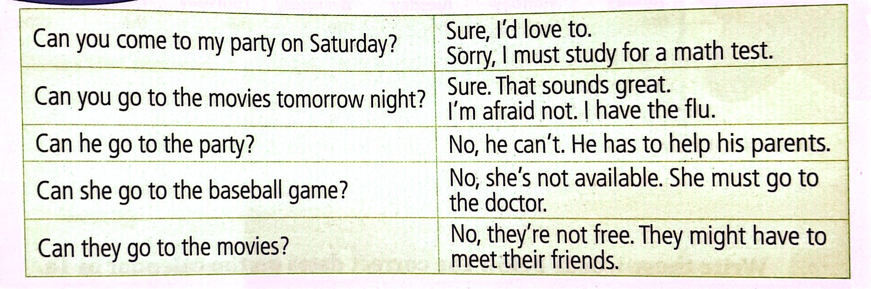
Can you find the rule?
can表示“做某事的可能性”。
无论主语是什么，动词用原形。
can引导的一般疑问句由Yes, ...can.或No, ...can’t.作回答。
might表示推测和可能性。
它的可能性比can, could ,may小,也最委婉，最有礼貌。

Slide 28
Listen to the conversations and role-play them.
Conversation 1
Anna: Hi, Jeff! Can you come to my party on Saturday?
Jeff: I’m sorry, I’m not free. I might have to meet my friend on Saturday.
Conversation 2
Anna: Hello, Mary! Can you come to my party on Saturday?
Mary: I’d love to. Do I need to bring anything?
Anna: No, I’ll buy all the food and drinks.

Slide 29
Conversation 3
Anna: May, can you come to my party tomorrow?
May: I’m afraid not. I have the flu.
Anna: Oh, that’s too bad. Well, drink lots of hot water and get lots of sleep.
Conversation 4
Anna: Mei Ling, can you come to my party on Saturday?
Mei Ling: Sorry, but I’m not available. I must study for a math test.
Anna: OK. Good luck!

Slide 30
Conversation 5
Anna: Hey, Paul. Can you come to my party on Saturday?
Paul: Sure. It sounds great. When will it start?
Anna: Around 6:00 p.m. See you then.
Paul: See you.

Slide 31


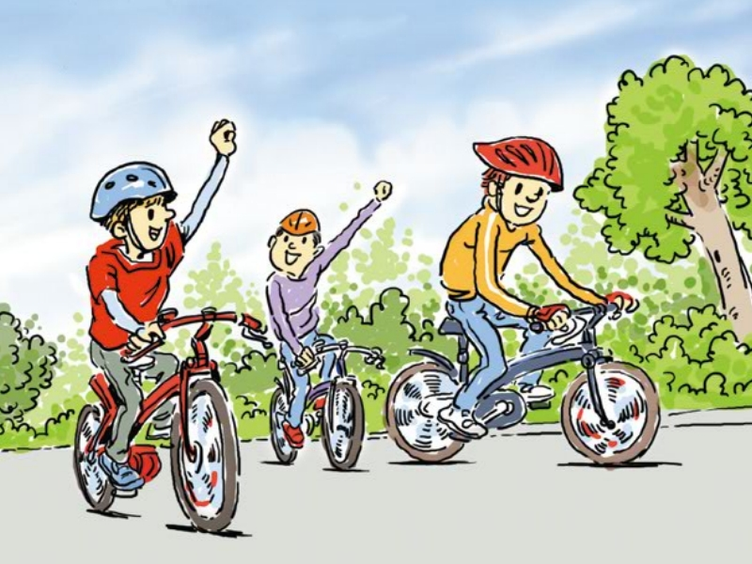
Listen to the conversation.
Jeff: Hey, Nick, can you come to my house on Saturday?
My cousin Sam from Xi’an is going to be here.
Nick: Oh, Sam! I remember we went bike riding together last fall
when he visited you.
Jeff: Yes, that’s right.
Nick: I’d love to come, but I’m afraid I can’t.
I have an exam on Monday so I must prepare for it.
Jeff: That’s really too bad! Oh, but Sam isn’t leaving until next Wednesday. Can you hang out with us on Monday night?
Nick: Sure! Catch you on Monday!

Slide 32
Read the conversation and answer the questions.
1. Why does Jeff invite Nick to his house on Saturday?
2. Does Nick accept the invitation at first? Why?
3. Does Nick accept the invitation at last? Why?
Because Jeff’s cousin Sam from Xi’an is coming.
No, he refuses the invitation firstly.
Because Nick will have an exam on Monday and he must prepare for it.
Yes,he does.
Because Sam isn’t leaving until next Wednesday and
Nick can hang out with them on Monday night.

Slide 33
Listen to the conversation.
Jeff: Hey, Nick, can you come to my house on Saturday?
My cousin Sam from Xi’an is going to be here.
Nick: Oh, Sam! I remember we went bike riding together last fall
when he visited you.
Jeff: Yes, that’s right.
Nick: I’d love to come, but I’m afraid I can’t.
I have an exam on Monday so I must prepare for it.
Jeff: That’s really too bad! Oh, but Sam isn’t leaving until next Wednesday. Can you hang out with us on Monday night?
Nick: Sure! Catch you on Monday!

Slide 34
Fill in the blanks according to the conversation.
Jeff’s _______ Sam _______ Xi’an is going to visit him on Saturday. Jeff and his friend Nick _______ bike riding together last fall when Sam came. But this Saturday Nick _______ come to Jeff’s house because he _______ _______ _______ an exam on Monday. Luckily, Sam isn’t leaving ______ next Wednesday. Nick can ______ them on Monday and then _______ _______ together on Monday night.
cousin
from
went
must prepare
for
can’t
until
catch
hang out

Slide 36
Listen again and match the names and answers.
Jeff
I’d love to.
Mary
I’m afraid not.
May
Sure. It sounds great.
Mei Ling
I’m sorry. I’m not free.
Paul
Sorry, but I’m not available (= free).

Slide 37
Jeff
May
Mei Ling
Mary
prepare for an exam
meet my friend

Slide 38
have the flu
go to the doctor
help my parents
n. 流行性感冒；流感
去看医生

Slide 39

– Can you come to my party?
– Sure , I’d love to.
– That sounds great /good.
– That would be nice.

Slide 40
– Can you come to my party?
Sorry, I can’t .
I have to…
I must…
I am going to…
– Sorry, I can’t . I have the flu, I must /have to go to the doctor.
– Sorry, I can’t . I am going to see a doctor.

Slide 41
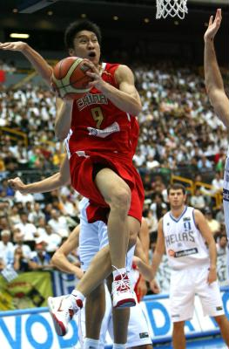
– Can you watch a basketball match with me?
– Sure, I’d love / like to.
– That sounds great / good.
– That would be nice.

Slide 42
– Can you go shopping with me tomorrow?
– Sorry, I can’t. I have to/must
prepare for an exam.
– Sorry, I’m afraid not.
I’m going to
prepare for an exam.

Slide 43
– Can you come to my party this Sunday?
– Sorry, I can’t. I have to/ must
go to the doctor.
– Sorry, I’m afraid not. I’m going to
see the doctor.

Slide 44

– Can you… with me?
– Sure , I’d love to.
– Sorry, I can’t . I have to/must …
/ I’m going to…

Slide 45
Listen again and fill in the blanks.
Names | Reasons
Ted | He has to help his parents.
Tim | He has to ______________________.
Wilson | He must _______________.
Anna | She might have to _______________.
Kay | She ______________.
prepare for an exam
go to the doctor
meet her friend
has the flu

Slide 46
Tim: When is it?
Sun Ning: Saturday afternoon.
Tim: Oh, no, I can’t. I have to prepare for an exam.
Sun Ning: What about you, Wilson?
Wilson: Sorry, I must go to the doctor.
Sun Ning: Anna, can you come?
Anna: I can’t, Sun Ning. I might have to meet my friend.
Kay: I can’t either, Sun Ning. I have the flu.
Sun Ning: That’s too bad, Kay. Oh, maybe next time. What a
small party!

Slide 47
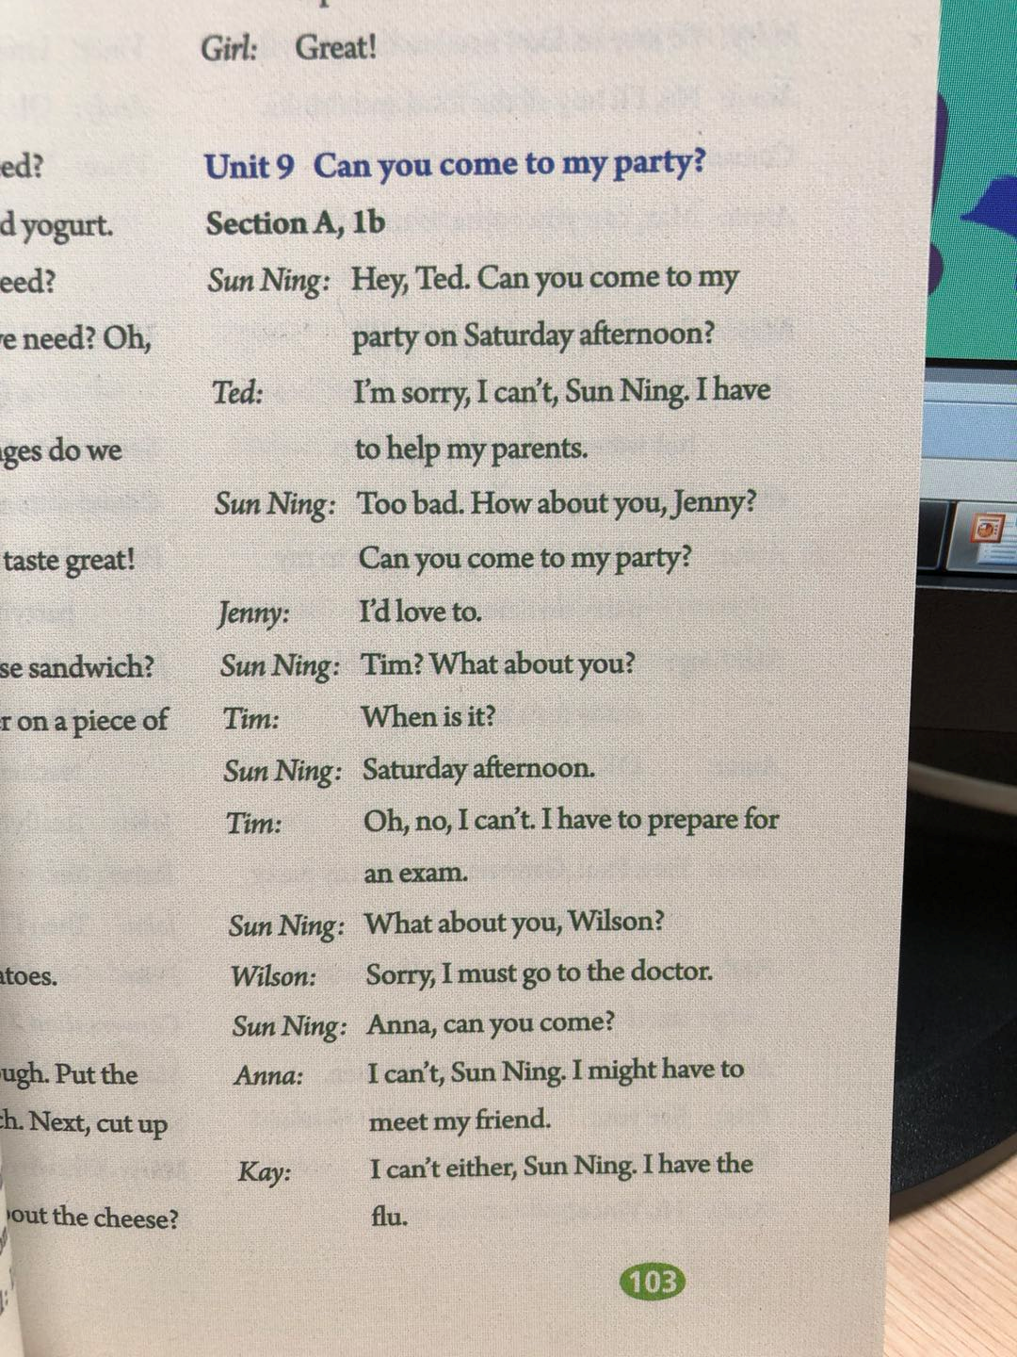
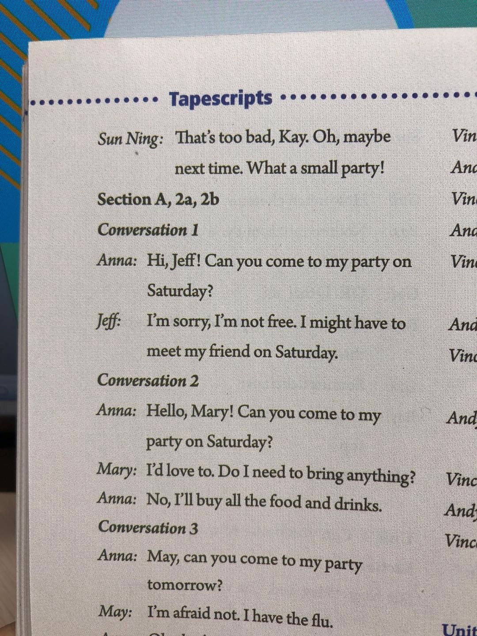
发出邀请
prepare for an exam / study for an exam
备考
在星期六下午
拒绝邀请
帮助我的父母
接受邀请
go to the / a doctor
去看医生
见我的朋友
have the flu 患流感

Slide 48
Sun Ning’s Invitation (邀请)
Make the invitation
Can you …?
Accept the invitation
I’d love to.
I’m sorry, I can’t.
No, I can’t.
Sorry.
I can’t (either).
I (might) have to…
I must …
Decline the invitation

Slide 49



You are the students in the picture. Student A, invite three students to your party. Student B, C and D, give answers.
A: Can you come to my party on Saturday afternoon?
B: Sure, I’d love to.
C: Sorry, I can’t. I have to prepare for an exam.
D: I’m sorry, too. I must go to the doctor.

Slide 50
Anna’s Invitation (邀请)
Make the invitation
Can you …?
I’d love to.
Sure. It sounds great.
Accept the invitation
I’m sorry, I’m not free.
I’m afraid not.
Sorry, but I’m not available.
I (might) have to… / I must …
Decline the invitation

Slide 51
礼貌地发出邀请：
Can you come to…?
Could you come to my party?
Would you like to come to my party?
接受邀请：
I’d love to.
Sure. It sounds great.
…

Slide 52
委婉拒绝邀请：
Sorry, I can’t. I have to …
I’m sorry. I’m not free then.
I’m sorry. I’m not available. I have ...
I’d love to come, but I’m afraid I can’t. I have ...

Slide 53
Student A invites student B to do something.
Student B says you can’t go and why.
Write some more reasons in the chart.
1. too much homework
2. ____________________
____________________
____________________
visit grandparents
have piano lessons
go to a concert (音乐会)

Slide 54
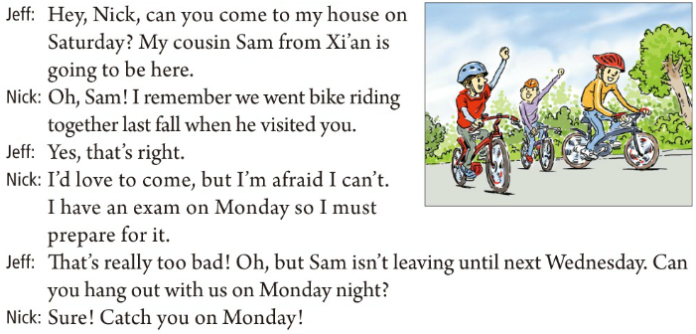
go bike riding 骑自行车兜风
去年秋天
闲逛；常去某处
礼拜一见！

Slide 55
礼貌地发出邀请：
Can you come to…?
Could you come to my party?
Would you like to come to my party?
接受邀请：
I’d love to.
Sure. It sounds great.
…

Slide 56
委婉拒绝邀请：
Sorry, I can’t. I have to …
I’m sorry. I’m not free then.
I’m sorry. I’m not available. I have ...
I’d love to come, but I’m afraid I can’t. I have ...

Slide 57


Ⅰ. 根据句意，从方框中选择恰当的单词填空, 注意形式变化。
available, exam, catch, flu
caught
1. The police _________ that criminal in the town.
2. Will you be _________ this Sunday? I’d like to invite you to dinner.
3. I felt like I had the _________. I didn’t feel very well.
4. Jake did well in all the ________. He is going out to celebrate.
available
flu
exams

Slide 58
Ⅱ. 根据句意及所给汉语提示，写出所缺内容，每空一词（含缩略形式）。
1. I’m busy right now. Could you come back _______ _______ (其他时间)?
2. I _______ _______ _______ _______ (去看医生) yesterday. He said my illness (病) was not serious.
3. The students are busy __________ _______ (为……做准备) the goodbye party.
another time
went to the / a doctor
preparing for

Slide 59
hang out
4. It is sunny, and I am happy to _______ _______ (闲逛) with my parents.
5. Yesterday, we _______ _______ _______ _______ (直到……才吃午饭) two o’clock.
didn’t have lunch until

Slide 60


Use what you have learned in this lesson to make up a new conversation among three people. One makes an invitation, the second person accepts it and the third person turns down it.

Slide 61


